Slide 1
The Consolidators Amit Kumar Dua Lakshmi Sowjanya Chunchu Akshay Agarwal Neha Dubey Diti Saxena
Air Pollution Analysis System

Slide 2
Need for Air Quality Monitoring ?
With the increasing level of pollutants in the environment which is a growing danger for human life
and respiratory problems, the Indian Government has been taking adequate measures to control the
pollution. With the vast spread of cities across our country there is a need to identify the areas which
need immediate attention and take corrective actions.
Goal:
Classify the regions in red, yellow and green zones based on the air pollutants levels
Send alerts to the concerned department on areas which need attention
Benefits :
Tackle Climate Change effectively
Environmental Benefits
Health Benefits

Slide 3





Data Science Pipeline
Data Collection
Feature Engineering
Algorithm Selection
Visualization
Train & Deploy
Algorithm
techniques
Score, Train
& predict
Report
Web Crawling
Data cleansing & engineering using scripts

Slide 4
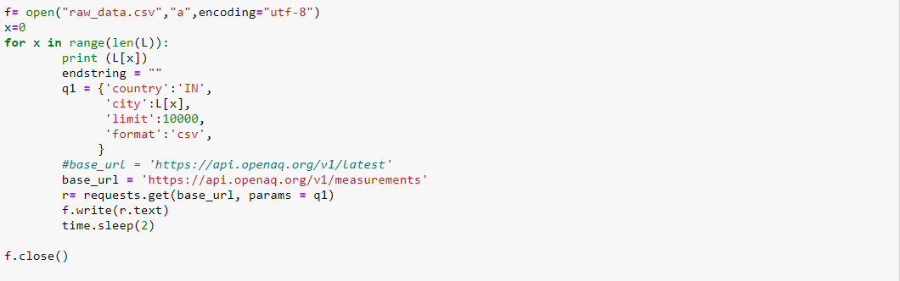
Code Snippet – Web Crawling
Reference : “https://openaq.org”

Slide 5
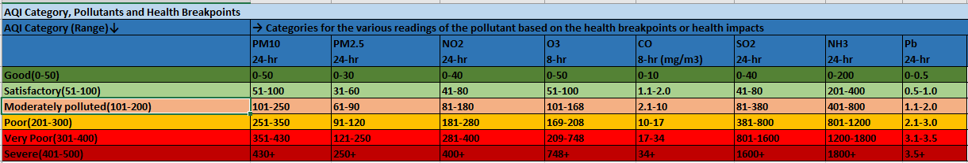
Quality Standards
Reference : “http://www.arthapedia.in/index.php?title=National_Air_Quality_Index”

Slide 6
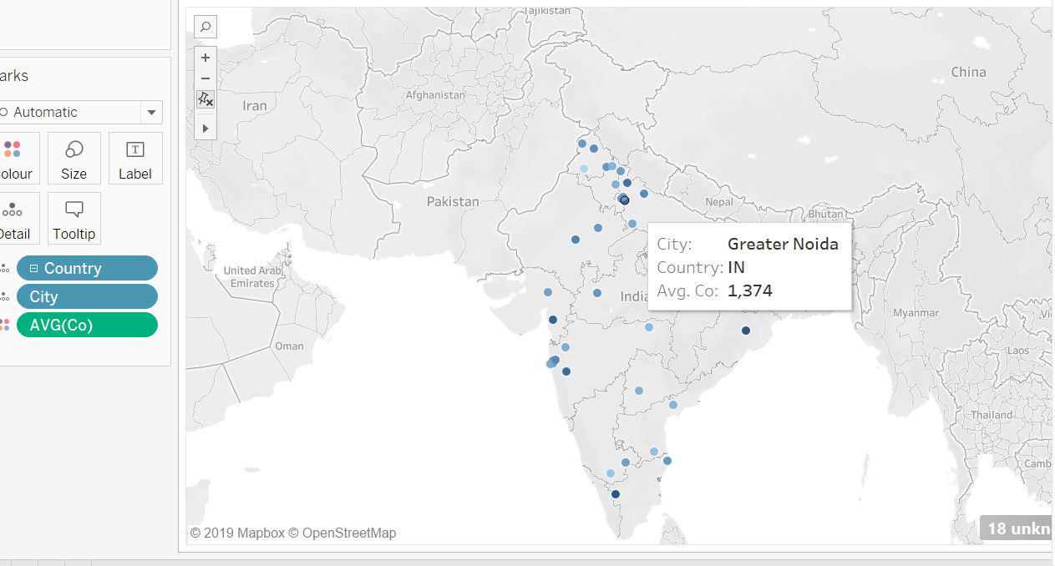
Report

Slide 7
Time for Hector? ☺

